Slide 1
Mutimedia
Parker Zhou
parkerzho2010@gmail.com

Slide 2

The Story So Far
Flash Player
ios not Support!
Video.js

Slide 3
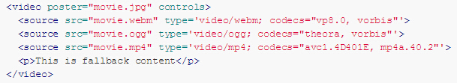
<vedio>
Autoplay
Controls
Height
Width
Loop
Muted
Poster

Slide 4
Video Format
Contianer fomat : .avi .mp4 .ogg .flv …
Contains two tracks : video and audio are both encoded
Browser must recognize the container format as well as be able to decode(codec) two encoded tracks

Slide 5
Video Format
Container | Video codec | Audio codec | Extension
Ogg | Theora | Vorbis | .ogv
MP4 | H.264(AVC) | AAC | .mp4
WebM | VP8 | Vorbis | .webm
MP3 |  | mp3 | .mp3

Slide 6
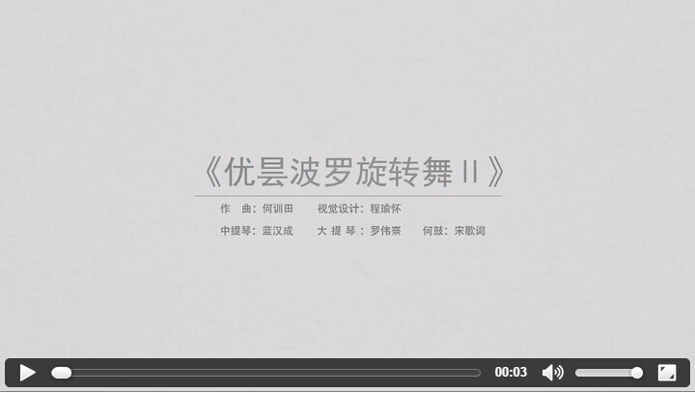
Simple Example
Notes:
http://file.tool.oriit.shcmusic.edu.cn/api/download/?key=4dc7725d-ffd1-4a33-98f9-ea83c62638dd.mp4&real=true
http://file.tool.oriit.shcmusic.edu.cn/api/download/?key=7887a320-6f9a-4a5c-891c-9c2b3718caa9.jpg

Slide 7
WebVTT
<track>
WEBVTT FILE
00:00:07.500 --> 00:00:08.750
He's fidgety.
00:00:09.000 --> 00:00:12.000
There he goes!!!

Slide 8
Video Seek
Video is stream
Key Frame Meta
Server Support (?start=xxx)

Slide 9
HTMLMediaElement methods
You are able to full control the media using javascript

